Slide 1
HTML & CSS *A11y Tips: making websites accessible
xbi 21 jan, 2025 v 1.3

Slide 2
A11y Tips
HTML
ARIA
CSS Basics & Overrides
Making text easier to read
Making links easier to see

Slide 3
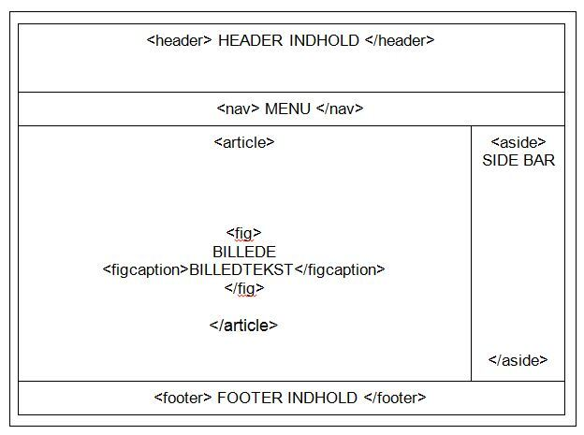
Accessible html:
Semantic HTML Elements
Use tags like <header>, <nav>, <main>, <ar­ ticle>, <section>, <aside>, and <footer> in stead of <div>

Slide 4
Enhancing Web Accessibility with ARIA
Making Web Applications Inclusive

Slide 5
ARIA and screen reader
https://youtu.be/0hqhAIjE_8I?si=IxFCj4pUBUDiQfec

Slide 6
Introduction to ARIA
ARIA stands for Accessible Rich Internet Applications.
It is a set of attributes that can be added to HTML elements to convey additional information to assistive technologies.
This additional information is invaluable for screen readers and other assistive technologies.
Notes:
Apple assistive technologie- Mac voiceover

Slide 7
ARIA Roles for Document Structure
Roles define the purpose of an element.
ARIA roles provide context about an element's function.
ARIA roles are especially useful when dealing with non-standard or custom UI components.

Slide 8
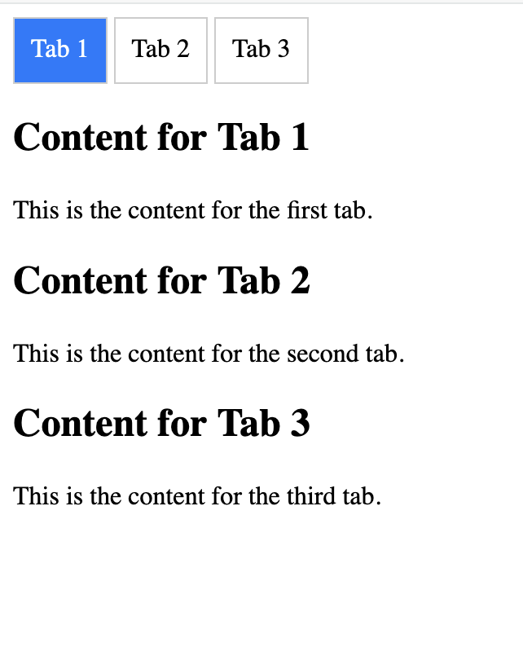
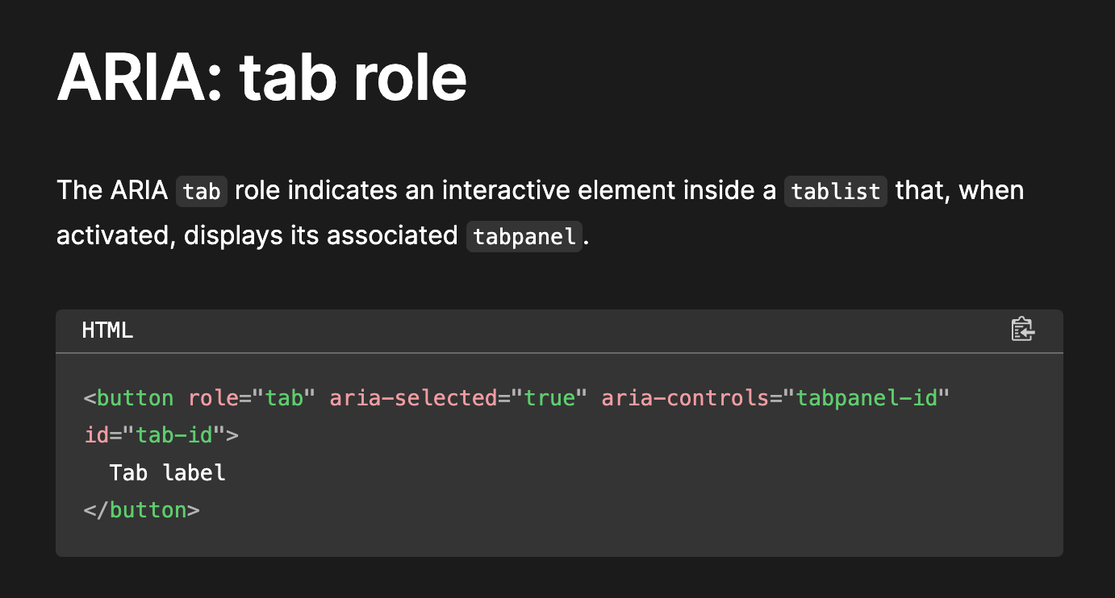

Slide 9
ARIA Attributes for Interactive Elements
ARIA attributes convey crucial information about an element's behavior, state, or properties.

Slide 10
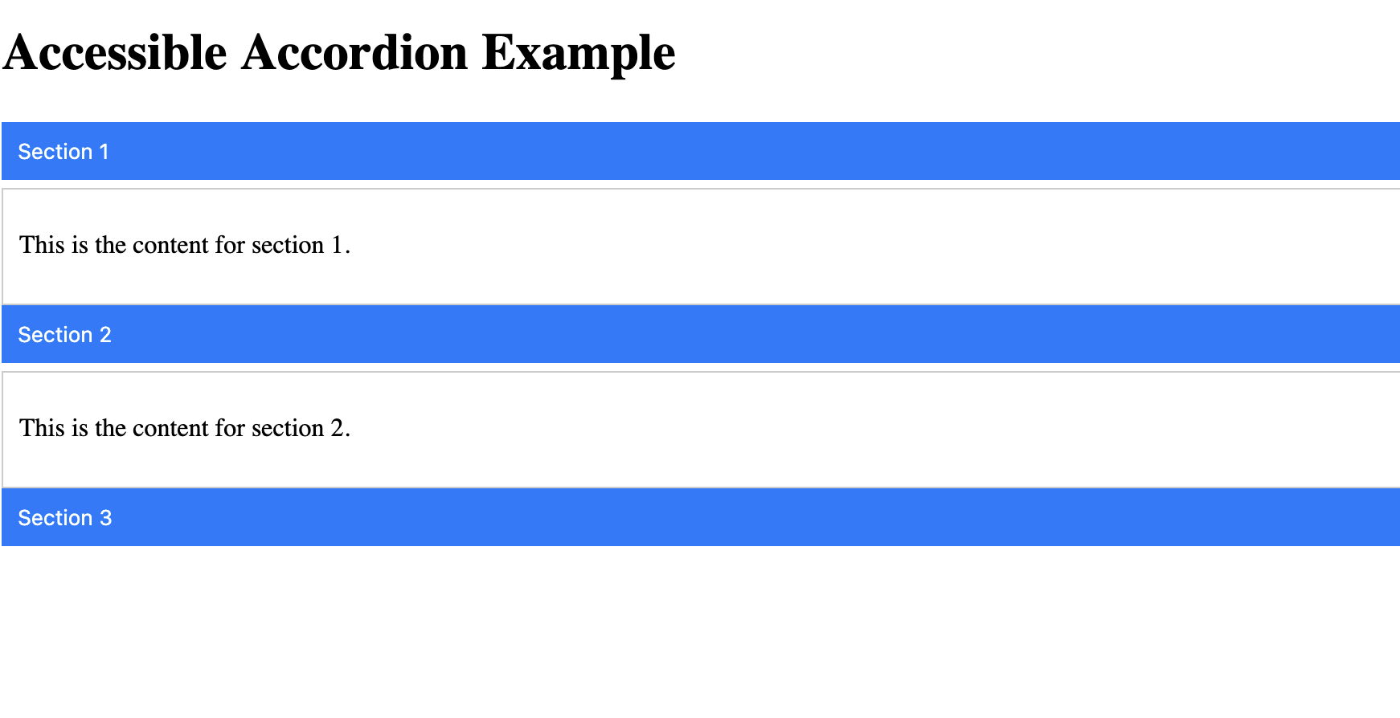
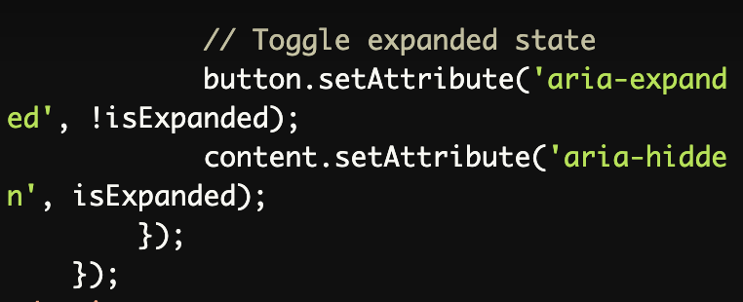
ARIA -Attribute

Slide 11
"no aria is better than bad aria"
Use ARIA roles only when necessary.
Use native HTML elements whenever possible.
Use ARIA attributes to supplement, not replace, native HTML semantics.
Notes:
https://www.a11ymatters.com/pattern/checkbox/ use h2 as label for the checkbox group

Slide 12
CSS Basics & Overrides

Slide 13
CSS belongs in stylesheet, not inline
Example of inline CSS: <span style=“color:blue”>Blue text</span>
Example of done in stylesheet: <span class=“blue-text”>Blue text</span>
The reason: A company changed their primary color. You can update a line of CSS or hundreds of inline styles.
Name it based on what people can remember. “Primary-color” for devs, “blue-text” for clients.

Slide 14
CSS variables are your friends
Variables allow you to update once, not a long search & replace.
:root { --link-color: #0000ff; /* blue */ }
.blue-text { color: var(--link-color); }

Slide 15
CSS color spaces: absolute values
#0000ff; // hex
rgb(0,0,255); // Red, Green, Blue
hsl(240,100%,50%) // Hue, Saturation, Lightness
Avoid alpha/opacity changes.

Slide 16
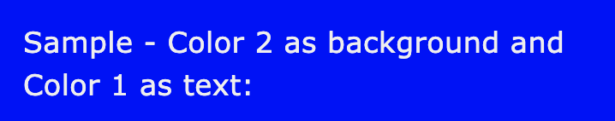
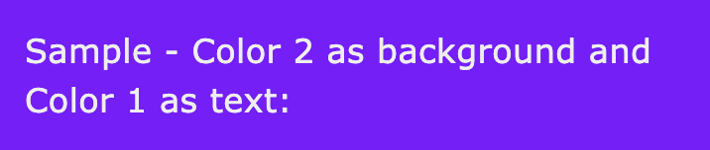
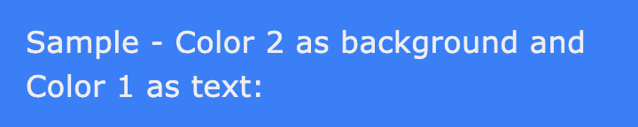
CSS color spaces: relative values
#0000ff; /* hex */
hsl(from #0000ff h s l); /* same blue color */
hsl(from #0000ff calc(h + 30) s l)
hsl(from #0000ff calc(h - 30) s l)

Slide 17
CSS Nesting
https://www.w3schools.com/cssref/tryit.php?filename=trycss_sel_nesting_after
Notes:
Can remove >:
• This is a child combinator
But need to keep the space

Slide 18
CSS !important
!important is the override of last resort.
body .wp-block-button__link, body .wp-block-button__link:visited { color: blue !important; }
Don’t use unless you need to.

Slide 19
Semantic HTML is less CSS work
Semantic HTML is easier to write CSS for since elements already have a number of properties set & handled by the browser.
<div>s are not <button>s.
<div>s are not <fieldset>s either.
<div> is the most generic HTML element, while very useful, make sure something else isn’t more appropriate.

Slide 20
Semantic HTML is good SEO

Slide 21
Keep items in their containers
Make sure embeds and iframes fit their containers.
embed, iframe, object { max-width: 100%; }

Slide 22
Making text easier to read

Slide 23
Setting your fonts
Respect the user’s font preferences. Use rems, not pixels.
html { font-size: 100%; }
body { font-size: 1rem; }

Slide 24
Setting your line-height
Set reasonable relative line height. Do not use pixels.
body, button, input, select, textarea { line-height: 1.5; }

Slide 25
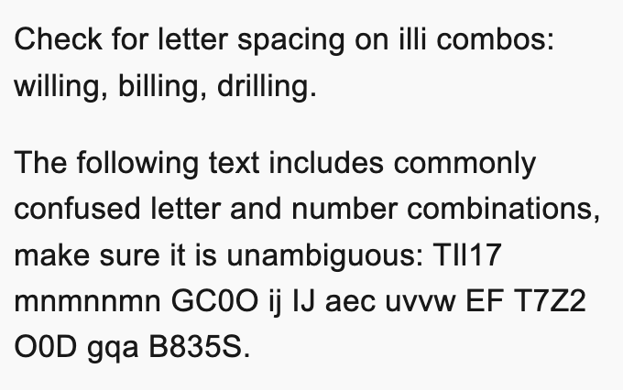
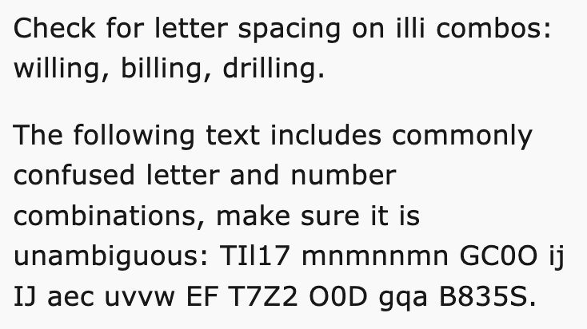
Slightly wider body fonts
Arial vs Verdana

Slide 26
Fallback fonts
Set fallback fonts to include web safe fonts & either serif or sans-serif.
Someday you will have a loading error on your fonts, this falls back gracefully.
body { font-family: Lato, Verdana, sans-serif; }

Slide 27
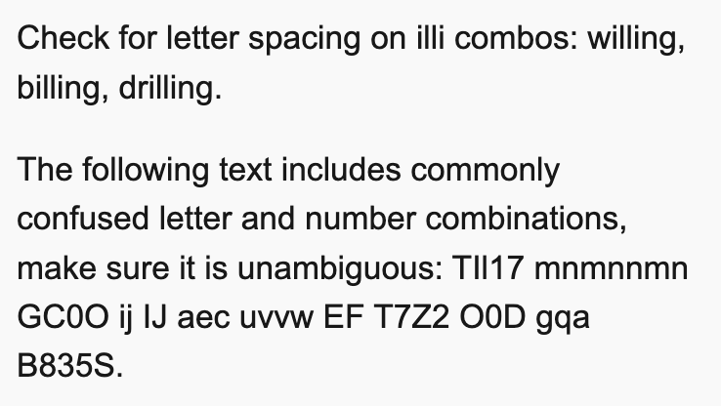
Letter spacing is your friend
Letter-spacing: 0.015em; /* or 0.2px; */

Slide 28
Making links easier to see

Slide 29
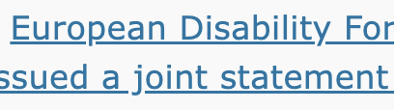
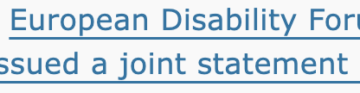
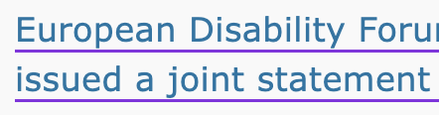
Add underline offset
Push the underline down so it doesn’t get broken.
Optionally, add a different color to it.
a {
text-underline-offset: 4px; text-decoration-color: blueviolet;
}

Slide 30
Checkboxes & Radios
Set the size of checkboxes & radios.
input[type=checkbox], input[type=radio] { min-width: 24px; min-height: 24px; width: 1.5rem; height: 1.5rem; }

Slide 31
Don’t forget :visited
a,
a:visited {
/* your styles */
}

Slide 32






Focus state: 2 colors
Use two colors to handle different background & foreground combos.

Slide 33


Focus state: dashed
Dashed border is visible regardless of background.
body a:focus, body a:visited:focus, body button:focus { outline: 2px solid var(--kaya-focus-color); border: 2px dashed white !important; }

Slide 34
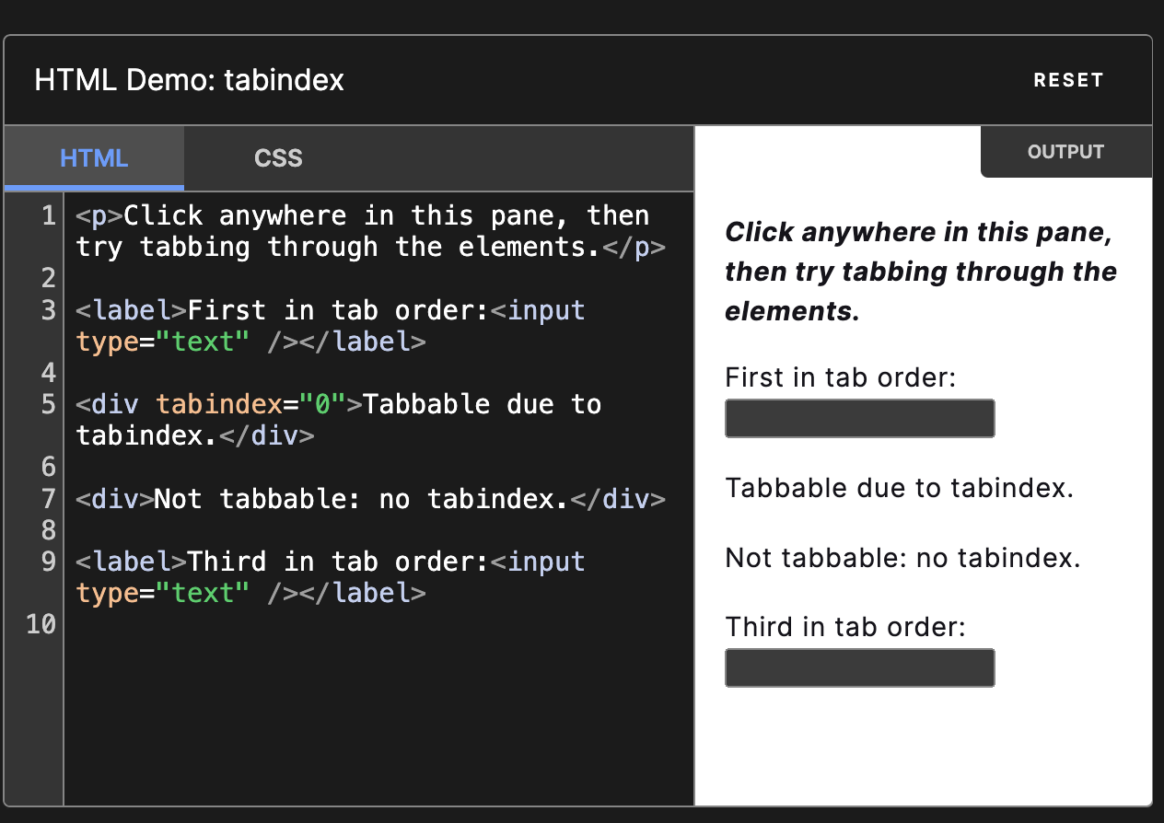
Keyboard tabindex=0
tabindex="0" attribute makes the link focusable using the “Tab” key and actionable using the “Enter” key.
tabindex - HTML: HyperText Markup Language | MDN (mozilla.org)

Slide 35
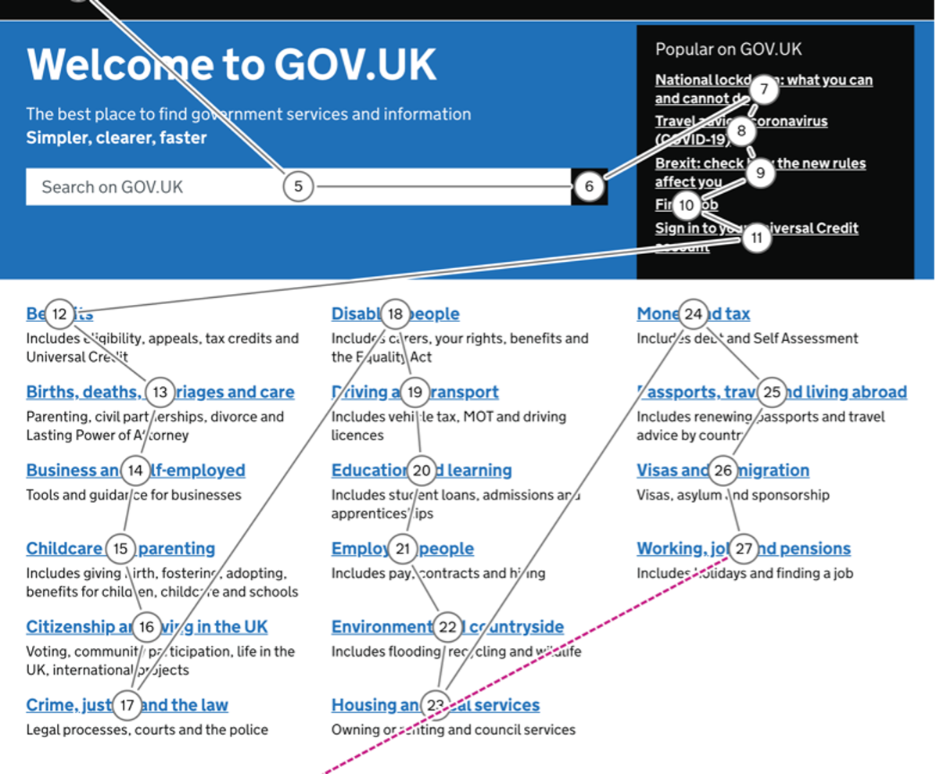
Notes:
https://design.homeoffice.gov.uk/accessibility/keyboard/focus

Slide 36
Source: Mastering HTML and CSS: Chapter 8: Web Accessibility. [Course document] https://www.a11yproject.com/checklist/

